Slide 1
Intro to Cookies and Authentication
Andrew Benson – CrashCourse 2014 - ScottyLabs

Slide 2
Overview
What are cookies
What are cookies used for
How are cookies sent between computers
Cookie Manipulation
Hashing
Writing a web server that defends against cookie manipulation

Slide 3
What are HTTP/web/browser cookies?
“a small piece of data sent from a website and stored in a user's web browser while the user is browsing that website” – Wikipedia
Up to 4KB, but usually way smaller
Servers send you cookies, your browser sends them back
Often represents “state”
Example cookie from Wikipedia:
mediaWiki.user.sessionId=P3kjMWM0ER6tUzafXRFWMXjWZOnMYQVV
KEY
VALUE

Slide 4
What can you do with cookies?
Login and Authentication
Shopping carts
Ad-tracking
Store temporary user preferences
Store data quickly if it’s not worth pinging a database

Slide 5


How are cookies sent? Usually through HTTP
GET / HTTP/1.1
Host: en.wikipedia.org
…
Cookie: GeoIP=US:Pittsburgh:40.4439:-79.9561:v4;uls-previous-languages=[“en”];mediaWiki.user.sessionId=P3kjMWM0ER6tUzafXRFWMXjWZOnMYQVV
…
Client Computer
HTTP/1.1 200 OK
…
Set-Cookie: GeoIP=US:Pittsburgh:40.4439:-79.9561:v4
Set-Cookie: uls-previous-languages=[“en”];
Set-Cookie: mediaWiki.user.sessionId=P3kjMWM0ER6tUzafXRFWMXjWZOnMYQVV
…
Wikipedia Server

Slide 6
Examples of Manipulating Cookies

Slide 7
JavaScript API
document.cookie
What more do you want?
Ex:
console.log(document.cookie); // prints JavaScript-accessible cookies
document.cookie = “KEY=VALUE”; // creates or replaces the cookie with key KEY and value VALUE
But you should just use the web developer tools usually…

Slide 8
Hashing
“one-way” function that converts something into a long string of characters, from which it is (in theory) impossible to get the original string
Ex)
hashlib.sha256(“bacon”).hexdigest() =‘9cca0703342e24806a9f64e08c053dca7f2cd90f10529af8ea872afb0a0c77d4’

Slide 9
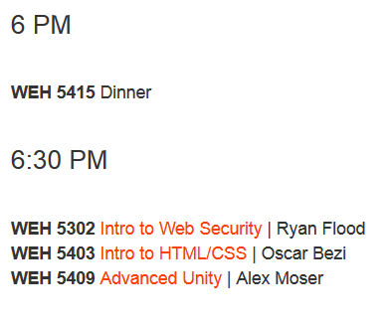
Next on the schedule

